Slide 1

Adopted from MIT Course
WHEATSTONE BRIDGE
FISIKA DASAR 2

Slide 2
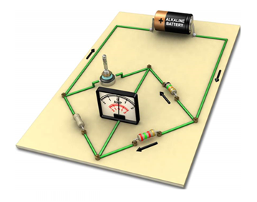

Wheatstone Bridge (Direct Current Bridge)
Wheatstone Bridge is an instrument that used to measure the resistance or change in resistance and converts it to output current
Wheatstone Bridge consists of two parallel resistance branches, each branch contains two series elements (resistance)
DC volt is used as a power source
Galvanometer is connected to detect balance or unbalanced condition
Adopted from MIT Course
Fig. 1. Wheatstone Brigde (Source: nationalmaglab.org)
2

Slide 3
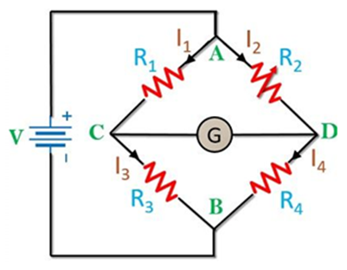
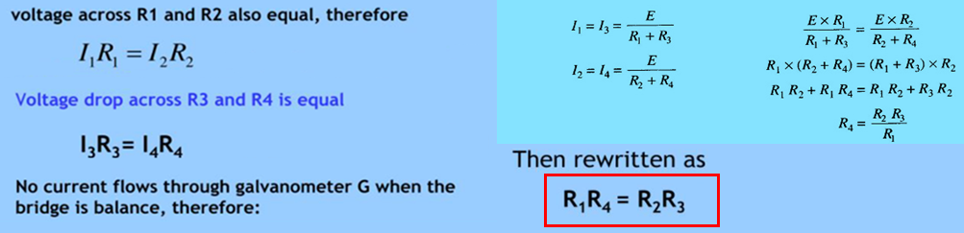

$Balance$ Condition
The bridge is balanced, when there is no current through the galvanometer, or when the potential difference at points C and D is equal, i.e. the potential across the galvanometer is zero.
V_{o} = V_{CD} = V_{C} – V_{D} = 0
I_{G} = 0
To obtain the bridge balance equation:
Fig. 2. Balance Condition
Adopted from MIT Course
3

Slide 4
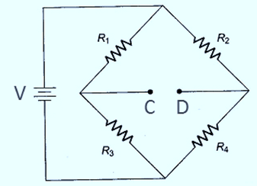

Unb$alance$ Condition
When the bridge is in an unbalance, current flows through the galvanometer, causing deflection of the pointer.
General circuit analysis can be applied, but we shall use Thevenin’s theorem since we are interested in determining the current through the galvanometer.
Thevenin’s equivalent voltage (V_{Th}) is found by disconnecting the galvanometer from the bridge, as shown in Fig. 4, and determining the open-circuit voltage between terminals C and D.
I_{G}
Fig. 3. Unbalance Condition
Adopted from MIT Course
Fig. 4. Unbalance Wheatstone’s Brigde
4

Slide 5
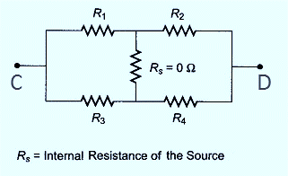
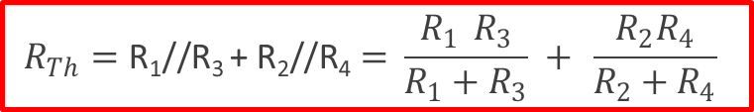

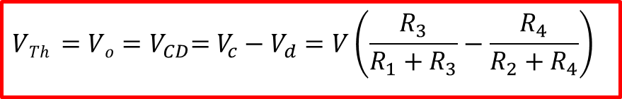

Applying the voltage divider equation, the voltage at point C and D can be deter­mined as follows
$$V_{c}=V\left(\frac{R_{3}}{R_{1}+R_{3}}\right)$$
$$V_{d}=V\left(\frac{R_{4}}{R_{2}+R_{4}}\right)$$
Therefore, the voltage between C and D is the difference between V_{C} and V_{D}, which represents Thevenin’s equivalent voltage (V_{Th})
$$VTh {=Vo=V}_{CD}=V_{c}−V_{d}=V\left(\frac{R_{3}}{R_{1}+R_{3}}−\frac{R_{4}}{R_{2}+R_{4}}\right)$$
Thevenin’s equivalent resistance circuit is shown in Fig. 5, with internal resistance is assumed to be very low (we treat it as 0 Ω). The equivalent resistance (R_{eq} = R_{Th}) of the circuit is: R₁//R₃ in series with R₂//R₄
$$R_{Th}=\text{R}\text{1}\text{//}\text{R}\text{3} \text{+ }\text{R}\text{2}\text{//}\text{R}\text{4}= \frac{R_{1} R_{3}}{R_{1}+R_{3}} + \frac{R_{2}R_{4}}{R_{2}+R_{4}}$$
Fig. 5. Thevenin’s Resintance
Adopted from MIT Course
5

Slide 6
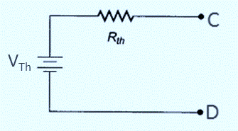
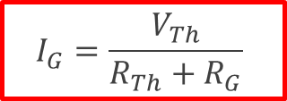
Thevenin’s equivalent circuit for the wheatstone bridge, as seen looking back at terminals C and D in Fig. 4 is shown in Fig. 6
Fig. 6. Thevenin’s Equivalent
If a galvanometer is connected across the terminals C and D of Thevenin’s equivalent circuit (Fig. 6), the deflection current flows as the output of the wheatstone bridge.
The magnitude of current is limited by both Thevenin’s equivalent resistance (R_{Th}) and any resistance connected between C and D (galvanometer resistance).
The deflection current in the galvanometer is therefore given by:
$$I_{G}=\frac{V_{Th}}{R_{Th}+R_{G}}$$
R_{G} is the internal resintance of galvanometer
Adopted from MIT Course
6

Slide 7
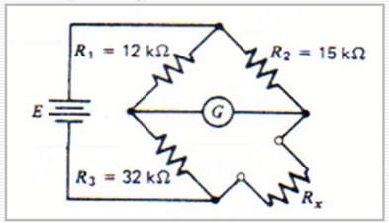
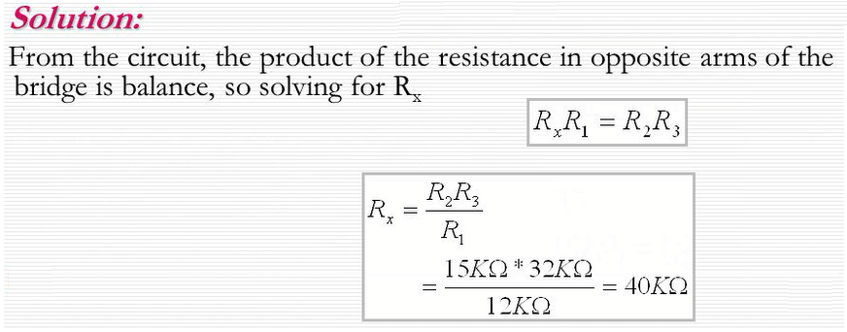
Example 1
Determine the value of unknown resistor (R_{x}) in the circuit.
Assuming a null exist, current through the galvanometer is zero.
7

Slide 8
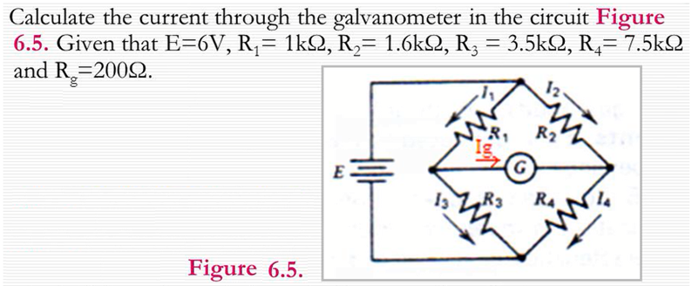
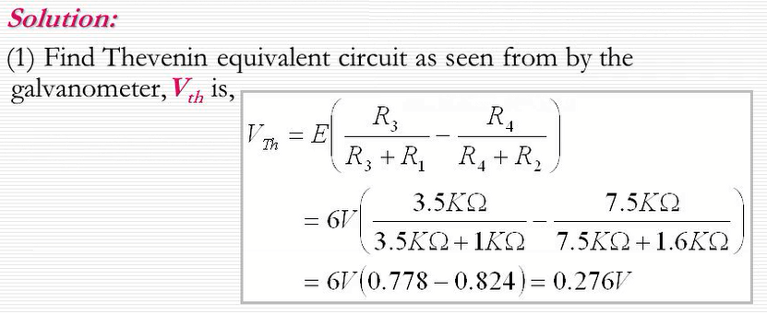
Example 2
8

Slide 9
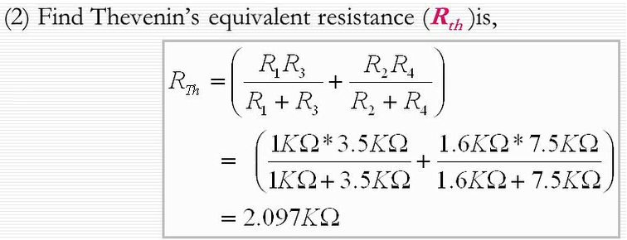
(3) Find current through Galvanometer
$I_{G}=\frac{V_{Th}}{R_{Th}+R_{G}}$ = $\frac{0.276}{2.097×103+200}=0,12 mA$
9

Slide 10
THANK YOU
10

